Slide 1
Zero Inflated Poisson Regression
“ZIP MODELS”

Slide 2
ZIP Models

Slide 3
“ZIP Counting Data”
Positive Integer Target Variable: 0, 1, 2, 3, etc. (counting numbers)
The data follows either
“Poisson” Distribution
“Negative Binomial” Distribution
… and a Large amount or “spike” of Zero values

Slide 4
“ZIP Counting Data”
EXAMPLE:
Note: The following data is synthetic and is based upon information found from a cursory internet search.
A random survey was conducted to determine the average number of minutes a person spent taking a shower the previous morning.
If a person took a shower, the average time spent in the shower followed a Poisson distribution with a mean value of 14 minutes.
However, approximately 12% of the people surveyed had not taken a shower the previous morning.

Slide 5
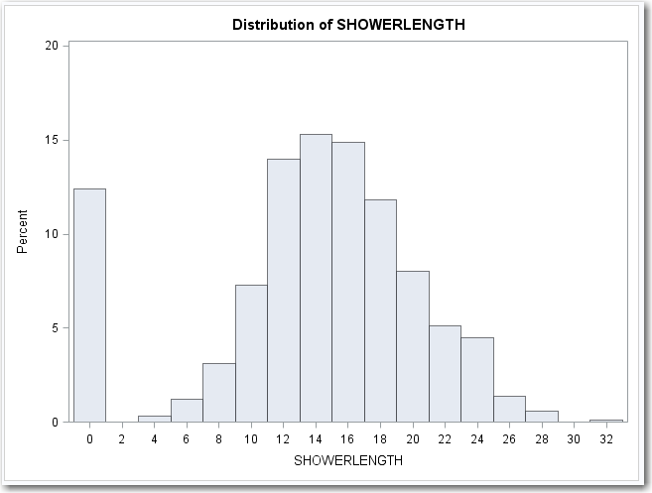
“ZIP Counting Data”
EXAMPLE: Distribution of the Synthetic Data Set representing length of time in the shower. Notice the large “spike” of zero values.

Slide 6
Create Synthetic Data

Slide 7
SAS Code For Generating Synthetic Shower Data 1 of 3
%let OUTFILE = SHOWER;
%let TEMPFILE = TEMPFILE;
%let NO_SHOWER = 0.25;
%let AVERAGE = 11;
%let HOWMANY = 1000;
%let MALE = M;
%let FEMALE = F;
%let MIDDLEAGE = MIDDLEAGE;
%let YOUNG = YOUNG;
%let ELDERLY = ELDERLY;

Slide 8
SAS Code For Generating Synthetic Shower Data 2 of 3
data &OUTFILE.;
length INDEX 8.;
length SHOWERLENGTH 8.;
SEED = 1;
do INDEX = 1 to &HOWMANY.;
AVERAGE = &AVERAGE.;
NOSHOWER = &NO_SHOWER.;
SEX = "&FEMALE.";
if ranuni(1) < 0.5 then SEX = "&MALE.";
if SEX in ("&FEMALE.") then do;
AVERAGE = AVERAGE + 2;
NOSHOWER = NOSHOWER - 0.1;
end;
AGE_RANGE = "&MIDDLEAGE.";
if ranuni(1) < 0.4 then AGE_RANGE = "&YOUNG.";
if ranuni(1) < 0.2 then AGE_RANGE = "&ELDERLY.";
if AGE_RANGE in ("&YOUNG.") then do;
AVERAGE = AVERAGE - 2;
end;

Slide 9
SAS Code For Generating Synthetic Shower Data 3 of 3
if AGE_RANGE in ("&ELDERLY.") then do;
AVERAGE = AVERAGE + 2;
NOSHOWER = NOSHOWER - 0.1;
end;
INCOME = 10000 + 50000*ranuni(1);
if SEX in ("&MALE.") then INCOME = 1.2*INCOME;
if AGE_RANGE in ("&YOUNG.") then INCOME = 0.7*INCOME;
if AGE_RANGE in ("&ELDERLY.") then INCOME = 0.9*INCOME;
INCOME = round(INCOME, 1000);
AVERAGE = AVERAGE + 0.10 * INCOME/1000.0;
BUCKET = round( INCOME / 10000,1 );
NOSHOWER = NOSHOWER - BUCKET/100.0;
INCOME = INCOME/1000;
call ranpoi(SEED, AVERAGE, ShowerLength);
if ranuni(1) < NOSHOWER then ShowerLength = 0;
output;
end;
drop SEED;
drop AVERAGE;
drop NOSHOWER;
drop BUCKET;
run;

Slide 10
Initial Analysis

Slide 11
Housekeeping Steps
data &TEMPFILE.;
set &OUTFILE.;
run;
proc print data=&TEMPFILE.(obs=10);
run;
proc means data=&TEMPFILE. mean var;
where ShowerLength > 0;
var ShowerLength;
run;
proc univariate data=&TEMPFILE. noprint;
histogram ShowerLength /midpoints = 0 2 4 6 8 10 12 14 ;
run;

Slide 12
Housekeeping Steps
It is a best practice to make a copy of the data set prior to doing any analytics on the data. This frees the analyst to alter the data set without worrying about destroying the original data set.
data &TEMPFILE.;
set &OUTFILE.;
run;
Another best practice is to print the data set, just to be certain that nothing went wrong when copying the data. The first TEN records are printed.
proc print data=&TEMPFILE.(obs=10);
run;

Slide 13
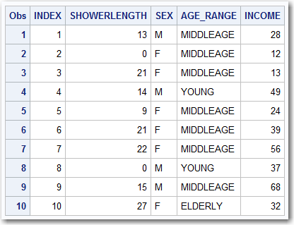
Housekeeping Steps

Slide 14
Housekeeping Steps
If this is a Poisson distribution, the MEAN and the VARIANCE will be the same.
The PROC MEANS statement is calculating the MEAN and the VARIANCE for the data that is NOT zero. Recall that if people take showers, the data has a Poisson distribution, however, some people did not take showers so their values are 0. The SAS code: where ShowerLength > 0; will remove the zero values from the data.
proc means data=&TEMPFILE. mean var;
where ShowerLength > 0;
var ShowerLength;
run;

Slide 15
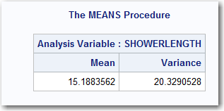
Housekeeping Steps
The output of the PROC MEANS suggests that the MEAN and the VARIANCE are similar to one another. They won’t be exact, but they are close.
This data can reasonably be considered to be either:
Poisson Distribution
Negative Binomial Distribution

Slide 16
Housekeeping Steps
It is usually a good idea to print the distribution of the target variable to verify that the data appears to have a Poisson distribution.
proc univariate data=&TEMPFILE. noprint;
histogram ShowerLength /midpoints = 0 2 4 6 8 10 12 14 ;
run;

Slide 17

Housekeeping Steps
The data appears to have a Poisson distribution or a Negative Binomial distribution (with the exception of the spike at the ZERO values).

Slide 18
Modeling ZIP Data

Slide 19
Modeling ZIP Data
Method 1: Poisson and/or
Negative Binomial Regression

Slide 20
Method 1: Poisson/Negative Binomial Regression
Method:
Solve the problem exactly like any other Poisson and/or Negative Binomial Model
Advantages:
Simple and familiar
No harm in trying because it might work (and many times it will)
Disadvantages:
It might not work

Slide 21
Method 1: Poisson/Negative Binomial Regression
SAS Code:
proc genmod data=&TEMPFILE.;
class SEX AGE_RANGE;
model ShowerLength = INCOME SEX AGE_RANGE / dist=poi link=log;
output out=&TEMPFILE. pred=P_TARGET_POI;
run;
proc genmod data=&TEMPFILE.;
class SEX AGE_RANGE;
model ShowerLength = INCOME SEX AGE_RANGE / dist=nb link=log;
output out=&TEMPFILE. pred=P_TARGET_NB;
run;

Slide 22
Method 1: Poisson/Negative Binomial Regression
SAS Code:
proc print data=&TEMPFILE.(obs=10);
var ShowerLength P_TARGET_POI P_TARGET_NB;
run;
proc univariate data=&TEMPFILE. noprint;
histogram ShowerLength /midpoints = 0 2 4 6 8 10 12 14 ;
histogram P_TARGET_POI /midpoints = 0 2 4 6 8 10 12 14 ;
histogram P_TARGET_NB /midpoints = 0 2 4 6 8 10 12 14 ;
run;

Slide 23
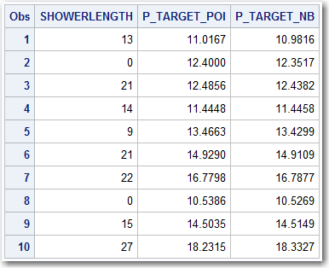
Method 1: Poisson/Negative Binomial Regression
SAS Code Output “PROC PRINT”:
The results from the PROC PRINT may not necessarily look like it’s a great fit, it will be shown later in this deck that it is more accurate than simply selecting an average value.

Slide 24
Method 1: Poisson/Negative Binomial Regression
SAS Code Output “PROC UNIVARIATE”:
The distribution of the Poisson and Negative Binomial models are somewhat similar to the actual data. They won’t have the “spike” at zero because these models won’t account for that. Nonetheless, they do appear to have some similarity.

Slide 25
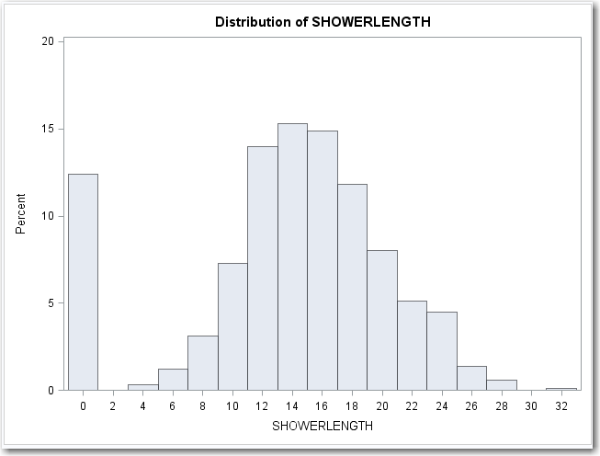
Method 1: Poisson/Negative Binomial Regression

Slide 26
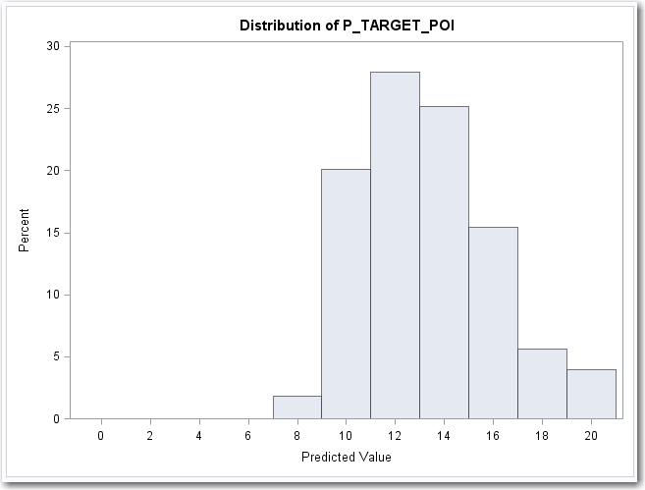
Method 1: Poisson/Negative Binomial Regression

Slide 27
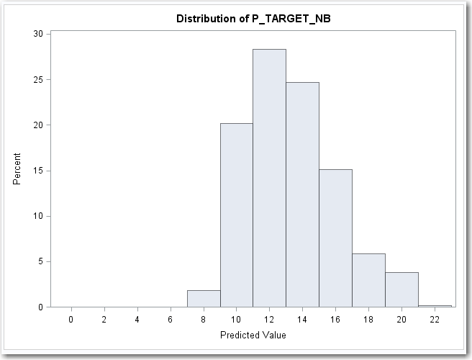
Method 1: Poisson/Negative Binomial Regression

Slide 28
Modeling ZIP Data
Method 2: Zero Inflated Poisson
“ZIP” Regression

Slide 29
Method 2: ZIP Regression
Method:
Use software, such as PROC GENMOD, that can handle Zero Inflated distribution
Generally requires creating a secondary model to predict if a variable is ZERO (usually a LOGISTIC model)
Advantages:
Not significantly more difficult than simply doing Poisson Regression
Can be highly accurate, especially if the “zero values” are easily identified
Disadvantages:
Required to build multiple models: One for the Poisson and a Logistic to predict if the value is a “zero”.
The “logistic” model won’t have all the options that might be available in a PROC LOGISTIC model.
Implementing a “stand alone” score program is more complicated

Slide 30
Method 2: ZIP Regression
SAS Code:
proc genmod data=&TEMPFILE.;
class SEX AGE_RANGE;
model ShowerLength = INCOME SEX AGE_RANGE / dist=ZIP link=log;
zeromodel SEX AGE_RANGE / link=logit;
output out=&TEMPFILE. pred=P_TARGET_ZIP pzero=P_ZERO_ZIP;
run;
The Code for a ZIP model is similar to a POISSON model or a Negative Binomial model. There are some minor differences:

Slide 31
Method 2: ZIP Regression
SAS Code:
proc genmod data=&TEMPFILE.;
class SEX AGE_RANGE;
model ShowerLength = INCOME SEX AGE_RANGE / dist=ZIP link=log;
zeromodel SEX AGE_RANGE / link=logit;
output out=&TEMPFILE. pred=P_TARGET_ZIP pzero=P_ZERO_ZIP;
run;
The distribution needs to be specified as “ZIP” instead of “POI” or “NB”.

Slide 32
Method 2: ZIP Regression
SAS Code:
proc genmod data=&TEMPFILE.;
class SEX AGE_RANGE;
model ShowerLength = INCOME SEX AGE_RANGE / dist=ZIP link=log;
zeromodel SEX AGE_RANGE / link=logit;
output out=&TEMPFILE. pred=P_TARGET_ZIP pzero=P_ZERO_ZIP;
run;
An additional line is added to GENMOD. This is the code to predict the probability that the count is a “zero” value.
In the above case, it is assumed that only SEX and AGE_RANGE predict whether a person took a shower that morning or skipped taking a show.

Slide 33
Method 2: ZIP Regression
SAS Code:
proc genmod data=&TEMPFILE.;
class SEX AGE_RANGE;
model ShowerLength = INCOME SEX AGE_RANGE / dist=ZIP link=log;
zeromodel SEX AGE_RANGE / link=logit;
output out=&TEMPFILE. pred=P_TARGET_ZIP pzero=P_ZERO_ZIP;
run;
It is possible to output the PROBABILITY that a value is ZERO as well as the expected value of the target.

Slide 34
Method 2: ZIP Regression
OUTPUT:
There will be two outputs from the ZIP model:
The coefficients predicting the amount of time a person will spend in the shower.
The coefficients predicting the probability that a value will be zero.

Slide 35
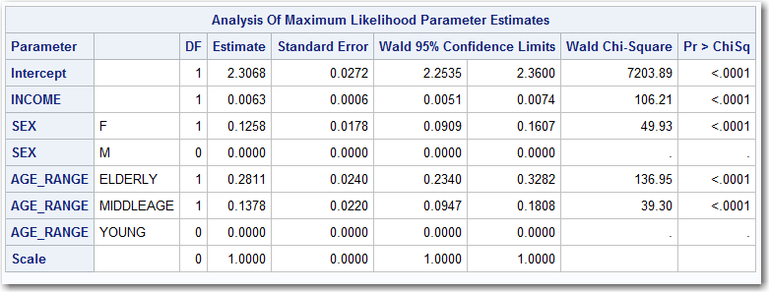
Method 2: ZIP Regression
OUTPUT:
Coefficients to predict the amount of time a person will spend in the shower *IF* they were to take a shower.

Slide 36
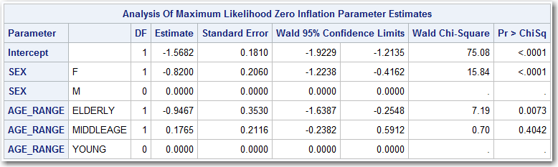
Method 2: ZIP Regression
OUTPUT:
Coefficients to predict LOG ODDS that a person will *NOT* take a shower. This needs to be converted from LOG ODDS to ODDS to PROBABILITY.

Slide 37
Method 2: ZIP Regression
CONVERTING PARAMETERS INTO SCORE CODE:
In order to create stand alone score code, both models need to be implemented into a data step. The first model, predicts the amount of time in the shower assuming that the person takes a shower (no zero values).
STEP 1: START WITH AN EMPTY DATA STEP
data &TEMPFILE.;
set &TEMPFILE.;
run;

Slide 38
Method 2: ZIP Regression
CONVERTING PARAMETERS INTO SCORE CODE:
STEP 2: Use the parameters from GENMOD to calculate the Natural LOG (“LN”) of the Shower Length (call this value “TEMP”).
data &TEMPFILE.;
set &TEMPFILE.;
TEMP = 2.3068 + INCOME * 0.0063
+ (SEX in ("F")) *0.1258
+ (AGE_RANGE in ("ELDERLY")) * 0.2811
+ (AGE_RANGE in ("MIDDLEAGE")) *0.1378;
run;

Slide 39
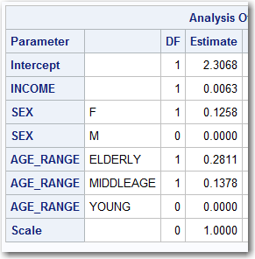
Method 2: ZIP Regression
CONVERTING PARAMETERS INTO SCORE CODE:
STEP 2: Use the parameters from GENMOD to calculate the Natural LOG (“LN”) of the Shower Length (call this value “TEMP”).
data &TEMPFILE.;
set &TEMPFILE.;
TEMP = 2.3068 + INCOME * 0.0063
+ (SEX in ("F")) *0.1258
+ (AGE_RANGE in ("ELDERLY")) * 0.2811
+ (AGE_RANGE in ("MIDDLEAGE")) *0.1378;
run;
The coefficients were found by PROC GENMOD.

Slide 40
Method 2: ZIP Regression
CONVERTING PARAMETERS INTO SCORE CODE:
STEP 2: Use the parameters from GENMOD to calculate the Natural LOG (“LN”) of the Shower Length (call this value “TEMP”).
data &TEMPFILE.;
set &TEMPFILE.;
TEMP = 2.3068 + INCOME * 0.0063
+ (SEX in ("F")) *0.1258
+ (AGE_RANGE in ("ELDERLY")) * 0.2811
+ (AGE_RANGE in ("MIDDLEAGE")) *0.1378;
run;

Slide 41
Method 2: ZIP Regression
CONVERTING PARAMETERS INTO SCORE CODE:
STEP 3: Now add code to convert TEMP into a variable representing the amount of time in the shower assuming a person takes a shower. Call this P_SCORE_ZIP_ALL.
data &TEMPFILE.;
set &TEMPFILE.;
TEMP = 2.3068 + INCOME * 0.0063
+ (SEX in ("F")) *0.1258
+ (AGE_RANGE in ("ELDERLY")) * 0.2811
+ (AGE_RANGE in ("MIDDLEAGE")) *0.1378;
P_SCORE_ZIP_ALL = exp( TEMP );
run;

Slide 42
Method 2: ZIP Regression
CONVERTING PARAMETERS INTO SCORE CODE:
STEP 3: Now add code to convert TEMP into a variable representing the amount of time in the shower assuming a person takes a shower. Call this P_SCORE_ZIP_ALL.
data &TEMPFILE.;
set &TEMPFILE.;
TEMP = 2.3068 + INCOME * 0.0063
+ (SEX in ("F")) *0.1258
+ (AGE_RANGE in ("ELDERLY")) * 0.2811
+ (AGE_RANGE in ("MIDDLEAGE")) *0.1378;
P_SCORE_ZIP_ALL = exp( TEMP );
run;

Slide 43
Method 2: ZIP Regression
CONVERTING PARAMETERS INTO SCORE CODE:
STEP 4: Use the parameters from GENMOD to calculate the LOGIT value that the person does *NOT* take a shower (call this value “TEMP”).
data &TEMPFILE.;
set &TEMPFILE.;
TEMP = 2.3068 + INCOME * 0.0063
+ (SEX in ("F")) *0.1258
+ (AGE_RANGE in ("ELDERLY")) * 0.2811
+ (AGE_RANGE in ("MIDDLEAGE")) *0.1378;
P_SCORE_ZIP_ALL = exp( TEMP );
TEMP = -1.5682 + (SEX in ("F")) *-0.8200
+ (AGE_RANGE in ("ELDERLY")) * -0.9467
+ (AGE_RANGE in ("MIDDLEAGE")) *0.1765;
run;

Slide 44
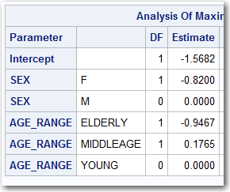
Method 2: ZIP Regression
CONVERTING PARAMETERS INTO SCORE CODE:
STEP 4: Use the parameters from GENMOD to calculate the LOGIT value that the person does *NOT* take a shower (call this value “TEMP”).
data &TEMPFILE.;
set &TEMPFILE.;
TEMP = 2.3068 + INCOME * 0.0063
+ (SEX in ("F")) *0.1258
+ (AGE_RANGE in ("ELDERLY")) * 0.2811
+ (AGE_RANGE in ("MIDDLEAGE")) *0.1378;
P_SCORE_ZIP_ALL = exp( TEMP );
TEMP = -1.5682 + (SEX in ("F")) *-0.8200
+ (AGE_RANGE in ("ELDERLY")) * -0.9467
+ (AGE_RANGE in ("MIDDLEAGE")) *0.1765;
run;
The coefficients were found by PROC GENMOD.

Slide 45
Method 2: ZIP Regression
CONVERTING PARAMETERS INTO SCORE CODE:
STEP 4: Use the parameters from GENMOD to calculate the LOGIT value that the person does *NOT* take a shower (call this value “TEMP”).
data &TEMPFILE.;
set &TEMPFILE.;
TEMP = 2.3068 + INCOME * 0.0063
+ (SEX in ("F")) *0.1258
+ (AGE_RANGE in ("ELDERLY")) * 0.2811
+ (AGE_RANGE in ("MIDDLEAGE")) *0.1378;
P_SCORE_ZIP_ALL = exp( TEMP );
TEMP = -1.5682 + (SEX in ("F")) *-0.8200
+ (AGE_RANGE in ("ELDERLY")) * -0.9467
+ (AGE_RANGE in ("MIDDLEAGE")) *0.1765;
run;

Slide 46
Method 2: ZIP Regression
CONVERTING PARAMETERS INTO SCORE CODE:
STEP 5: Convert the LOGIT (aka “TEMP”) into the PROBABILITY that a person does NOT take a shower. Call this variable P_SCORE_ZERO.
data &TEMPFILE.;
set &TEMPFILE.;
TEMP = 2.3068 + INCOME * 0.0063
+ (SEX in ("F")) *0.1258
+ (AGE_RANGE in ("ELDERLY")) * 0.2811
+ (AGE_RANGE in ("MIDDLEAGE")) *0.1378;
P_SCORE_ZIP_ALL = exp( TEMP );
TEMP = -1.5682 + (SEX in ("F")) *-0.8200
+ (AGE_RANGE in ("ELDERLY")) * -0.9467
+ (AGE_RANGE in ("MIDDLEAGE")) *0.1765;
P_SCORE_ZERO = exp(TEMP)/(1+exp(TEMP));
run;

Slide 47
Method 2: ZIP Regression
CONVERTING PARAMETERS INTO SCORE CODE:
STEP 6: Calculate the EXPECTED time in the shower. This will be the Time in the shower (assuming that a shower was taken) “P_SCORE_ZIP_ALL” multiplied by the probability that a person takes a shower (1 minus the probability that they don’t take a shower) “P_SCORE_ZERO”. Call this new value “P_SCORE_ZIP”
data &TEMPFILE.;
set &TEMPFILE.;
TEMP = 2.3068 + INCOME * 0.0063
+ (SEX in ("F")) *0.1258
+ (AGE_RANGE in ("ELDERLY")) * 0.2811
+ (AGE_RANGE in ("MIDDLEAGE")) *0.1378;
P_SCORE_ZIP_ALL = exp( TEMP );
TEMP = -1.5682 + (SEX in ("F")) *-0.8200
+ (AGE_RANGE in ("ELDERLY")) * -0.9467
+ (AGE_RANGE in ("MIDDLEAGE")) *0.1765;
P_SCORE_ZERO = exp(TEMP)/(1+exp(TEMP));
P_SCORE_ZIP = P_SCORE_ZIP_ALL * (1-P_SCORE_ZERO);
run;

Slide 48
Method 2: ZIP Regression
CONVERTING PARAMETERS INTO SCORE CODE:
STEP 6: Calculate the EXPECTED time in the shower. This will be the Time in the shower (assuming that a shower was taken) “P_SCORE_ZIP_ALL” multiplied by the probability that a person takes a shower (1 minus the probability that they don’t take a shower) “P_SCORE_ZERO”. Call this new value “P_SCORE_ZIP”
data &TEMPFILE.;
set &TEMPFILE.;
TEMP = 2.3068 + INCOME * 0.0063
+ (SEX in ("F")) *0.1258
+ (AGE_RANGE in ("ELDERLY")) * 0.2811
+ (AGE_RANGE in ("MIDDLEAGE")) *0.1378;
P_SCORE_ZIP_ALL = exp( TEMP );
TEMP = -1.5682 + (SEX in ("F")) *-0.8200
+ (AGE_RANGE in ("ELDERLY")) * -0.9467
+ (AGE_RANGE in ("MIDDLEAGE")) *0.1765;
P_SCORE_ZERO = exp(TEMP)/(1+exp(TEMP));
P_SCORE_ZIP = P_SCORE_ZIP_ALL * (1-P_SCORE_ZERO);
run;

Slide 49
Method 2: ZIP Regression
CONVERTING PARAMETERS INTO SCORE CODE:
STEP 6: Calculate the EXPECTED time in the shower. This will be the Time in the shower (assuming that a shower was taken) “P_SCORE_ZIP_ALL” multiplied by the probability that a person takes a shower (1 minus the probability that they don’t take a shower) “P_SCORE_ZERO”. Call this new value “P_SCORE_ZIP”
data &TEMPFILE.;
set &TEMPFILE.;
TEMP = 2.3068 + INCOME * 0.0063
+ (SEX in ("F")) *0.1258
+ (AGE_RANGE in ("ELDERLY")) * 0.2811
+ (AGE_RANGE in ("MIDDLEAGE")) *0.1378;
P_SCORE_ZIP_ALL = exp( TEMP );
TEMP = -1.5682 + (SEX in ("F")) *-0.8200
+ (AGE_RANGE in ("ELDERLY")) * -0.9467
+ (AGE_RANGE in ("MIDDLEAGE")) *0.1765;
P_SCORE_ZERO = exp(TEMP)/(1+exp(TEMP));
P_SCORE_ZIP = P_SCORE_ZIP_ALL * (1-P_SCORE_ZERO);
run;

Slide 50
Method 2: ZIP Regression
CONVERTING PARAMETERS INTO SCORE CODE:
STEP 6: Calculate the EXPECTED time in the shower. This will be the Time in the shower (assuming that a shower was taken) “P_SCORE_ZIP_ALL” multiplied by the probability that a person takes a shower (1 minus the probability that they don’t take a shower) “P_SCORE_ZERO”. Call this new value “P_SCORE_ZIP”
data &TEMPFILE.;
set &TEMPFILE.;
TEMP = 2.3068 + INCOME * 0.0063
+ (SEX in ("F")) *0.1258
+ (AGE_RANGE in ("ELDERLY")) * 0.2811
+ (AGE_RANGE in ("MIDDLEAGE")) *0.1378;
P_SCORE_ZIP_ALL = exp( TEMP );
TEMP = -1.5682 + (SEX in ("F")) *-0.8200
+ (AGE_RANGE in ("ELDERLY")) * -0.9467
+ (AGE_RANGE in ("MIDDLEAGE")) *0.1765;
P_SCORE_ZERO = exp(TEMP)/(1+exp(TEMP));
P_SCORE_ZIP = P_SCORE_ZIP_ALL * (1-P_SCORE_ZERO);
run;

Slide 51
Method 2: ZIP Regression
CHECK THAT PROBABILITY OF NO SHOWER IS THE SAME:
A PROC PRINT of the first 10 values will demonstrate that the probability value of “NO SHOWER” is the same value from PROC GENMOD and from the SCORE CODE.
proc print data=&TEMPFILE.(obs=10);
var P_ZERO_ZIP P_SCORE_ZERO;
run;;

Slide 52
Method 2: ZIP Regression
CHECK THAT PROBABILITY OF NO SHOWER IS THE SAME:
A PROC PRINT of the first 10 values will demonstrate that the probability value of “NO SHOWER” is the same value from PROC GENMOD and from the SCORE CODE.
proc print data=&TEMPFILE.(obs=10);
var P_ZERO_ZIP P_SCORE_ZERO;
run;;

Slide 53
Method 2: ZIP Regression
CHECK THAT PROBABILITY OF NO SHOWER IS THE SAME:
A PROC PRINT of the first 10 values will demonstrate that the probability value of “NO SHOWER” is the same value from PROC GENMOD and from the SCORE CODE.
proc print data=&TEMPFILE.(obs=10);
var P_ZERO_ZIP P_SCORE_ZERO;
run;;

Slide 54
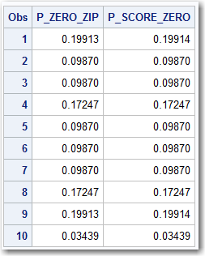
Method 2: ZIP Regression
CHECK THAT PROBABILITY OF NO SHOWER IS THE SAME:
A PROC PRINT of the first 10 values will demonstrate that the probability value of “NO SHOWER” is the same value from PROC GENMOD and from the SCORE CODE. Checking the output, the numbers are virtually identical.
proc print data=&TEMPFILE.(obs=10);
var P_ZERO_ZIP P_SCORE_ZERO;
run;;

Slide 55
Method 2: ZIP Regression
CHECK THAT EXPECTED TIME IN THE SHOWER IS THE SAME:
A PROC PRINT of the first 10 values will demonstrate that the probability value of the expected time in the shower is the same value from PROC GENMOD and from the SCORE CODE.
proc print data=&TEMPFILE.(obs=10);
var P_TARGET_ZIP P_SCORE_ZIP;
run;

Slide 56
Method 2: ZIP Regression
CHECK THAT EXPECTED TIME IN THE SHOWER IS THE SAME:
A PROC PRINT of the first 10 values will demonstrate that the probability value of the expected time in the shower is the same value from PROC GENMOD and from the SCORE CODE.
proc print data=&TEMPFILE.(obs=10);
var P_TARGET_ZIP P_SCORE_ZIP;
run;

Slide 57
Method 2: ZIP Regression
CHECK THAT EXPECTED TIME IN THE SHOWER IS THE SAME:
A PROC PRINT of the first 10 values will demonstrate that the probability value of the expected time in the shower is the same value from PROC GENMOD and from the SCORE CODE.
proc print data=&TEMPFILE.(obs=10);
var P_TARGET_ZIP P_SCORE_ZIP;
run;

Slide 58
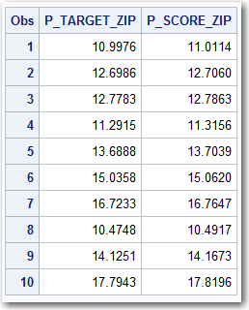
Method 2: ZIP Regression
CHECK THAT EXPECTED TIME IN THE SHOWER IS THE SAME:
A PROC PRINT of the first 10 values will demonstrate that the probability value of the expected time in the shower is the same value from PROC GENMOD and from the SCORE CODE. The values are close, but there are rounding errors.
proc print data=&TEMPFILE.(obs=10);
var P_TARGET_ZIP P_SCORE_ZIP;
run;

Slide 59
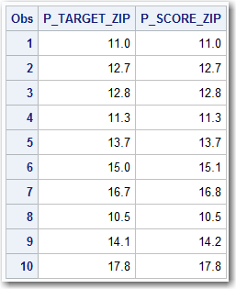
Method 2: ZIP Regression
CHECK THAT EXPECTED TIME IN THE SHOWER IS THE SAME:
A PROC PRINT of the first 10 values will demonstrate that the probability value of the expected time in the shower is the same value from PROC GENMOD and from the SCORE CODE. The values are close, but there are rounding errors. Rounding to the nearest 0.1, the values are shown to be close.
proc print data=&TEMPFILE.(obs=10);
var P_TARGET_ZIP P_SCORE_ZIP;
run;
data &TEMPFILE.;
set &TEMPFILE.;
P_TARGET_ZIP = round(P_TARGET_ZIP,0.1);
P_SCORE_ZIP = round(P_SCORE_ZIP,0.1);
run;
proc print data=&TEMPFILE.(obs=10);
var P_TARGET_ZIP P_SCORE_ZIP;
run;

Slide 60
Modeling ZIP Data
Method 3: Zero Inflated Negative Binomial “ZINB” Regression

Slide 61
Method 3: ZINB Regression
Method:
Exactly the same as Method 2: ZIP Regression, except that it is a different distribution. Use “ZINB” instead of “ZIP”
Advantages:
Everything is the same as ZIP … including the advantages.
Since there are virtually no differences, why not try ZINB and see what happens.
Disadvantages:
Same as ZIP

Slide 62
Method 3: ZINB Regression
SAS Code:
proc genmod data=&TEMPFILE.;
class SEX AGE_RANGE;
model ShowerLength = INCOME SEX AGE_RANGE / dist=ZIP link=log;
zeromodel SEX AGE_RANGE / link=logit;
output out=&TEMPFILE. pred=P_TARGET_ZINB pzero=P_ZERO_ZINB;
run;
The Code for a ZINB model is similar to a ZIP model except that the ZIP option is changed to ZINB.

Slide 63
Method 3: ZINB Regression
SAS Code:
proc genmod data=&TEMPFILE.;
class SEX AGE_RANGE;
model ShowerLength = INCOME SEX AGE_RANGE / dist=ZINB link=log;
zeromodel SEX AGE_RANGE / link=logit;
output out=&TEMPFILE. pred=P_TARGET_ZINB pzero=P_ZERO_ZINB;
run;
The Code for a ZINB model is similar to a ZIP model except that the ZIP option is changed to ZINB.

Slide 64
Method 3: ZINB Regression
SAS Code:
proc genmod data=&TEMPFILE.;
class SEX AGE_RANGE;
model ShowerLength = INCOME SEX AGE_RANGE / dist=ZINB link=log;
zeromodel SEX AGE_RANGE / link=logit;
output out=&TEMPFILE. pred=P_TARGET_ZINB pzero=P_ZERO_ZINB;
run;
The Code for a ZINB model is similar to a ZIP model except that the ZIP option is changed to ZINB.

Slide 65
Method 3: ZINB Regression
SAS Code:
proc genmod data=&TEMPFILE.;
class SEX AGE_RANGE;
model ShowerLength = INCOME SEX AGE_RANGE / dist=ZINB link=log;
zeromodel SEX AGE_RANGE / link=logit;
output out=&TEMPFILE. pred=P_TARGET_ZINB pzero=P_ZERO_ZINB;
run;
The Code for a ZINB model is similar to a ZIP model except that the ZIP option is changed to ZINB.
Sometimes, the NEGATIVE BINOMIAL distribution models will converge to the same solution as the POISSON models. In those cases, it might be useful to use different parameters in MODEL and/or ZEROMODEL because getting different answers will improve the chances of finding a good model.

Slide 66
Method 3: ZINB Regression
SAS Code:
proc genmod data=&TEMPFILE.;
class SEX AGE_RANGE;
model ShowerLength = INCOME SEX AGE_RANGE / dist=ZINB link=log;
zeromodel INCOME SEX AGE_RANGE / link=logit;
output out=&TEMPFILE. pred=P_TARGET_ZINB pzero=P_ZERO_ZINB;
run;
The Code for a ZINB model is similar to a ZIP model except that the ZIP option is changed to ZINB.
Sometimes, the NEGATIVE BINOMIAL distribution models will converge to the same solution as the POISSON models. In those cases, it might be useful to use different parameters in MODEL and/or ZEROMODEL because getting different answers will improve the chances of finding a good model.

Slide 67
Method 3: ZINB Regression
SAS Code:
proc genmod data=&TEMPFILE.;
class SEX AGE_RANGE;
model ShowerLength = INCOME SEX AGE_RANGE / dist=ZINB link=log;
zeromodel INCOME SEX AGE_RANGE / link=logit;
output out=&TEMPFILE. pred=P_TARGET_ZINB pzero=P_ZERO_ZINB;
run;
The Code for a ZINB model is similar to a ZIP model except that the ZIP option is changed to ZINB.
Sometimes, the NEGATIVE BINOMIAL distribution models will converge to the same solution as the POISSON models. In those cases, it might be useful to use different parameters in MODEL and/or ZEROMODEL because getting different answers will improve the chances of finding a good model.

Slide 68
Modeling ZIP Data
Method 4: Logistic Hurdle Model

Slide 69
Method 4: Logistic Hurdle Model
Method:
Build a Logistic Regression Model to predict if the count is “0” or “not 0”
Build a model to predict the count value (assuming it is not 0)
Multiply the probability of “not 0” by the count to get the expected count
Advantages:
Flexible and Versatile:
Advantage of having access to specialized logistic regression software allowing for options such as FORWARD/BACKWARD/STEPWISE regression
The “0” and “Not 0” model can be any type of model (“Tree”, “Neural Net”, etc.)
Count model can be any type of model (“Regression”, “Tree”, “Neural Network”, etc.).
Can even use different types of software (“R”, “Python”,”SAS”, etc.)
Disadvantages:
This can make things a lot more complicated

Slide 70
Method 4: Logistic Hurdle Model
SAS Code:
data &TEMPFILE.;
set &TEMPFILE.;
TARGET_FLAG = (ShowerLength>0);
TARGET_AMT = ShowerLength - 1;
if TARGET_FLAG = 0 then TARGET_AMT = .;
run;
proc logistic data=&TEMPFILE.;
class SEX AGE_RANGE / param = ref ;
model TARGET_FLAG(ref="0") = INCOME SEX AGE_RANGE /selection=stepwise;
output out=&TEMPFILE. pred=P_TARGET_FLAG;
run;
proc genmod data=&TEMPFILE.;
class SEX AGE_RANGE;
model TARGET_AMT = INCOME SEX AGE_RANGE / dist=poi link=log;
output out=&TEMPFILE. pred=P_TARGET_AMT;
run;
data &TEMPFILE.;
set &TEMPFILE.;
P_TARGET_HURDLE = P_TARGET_FLAG * (P_TARGET_AMT+1);
run;

Slide 71
Method 4: Logistic Hurdle Model
SAS Code:
For a Logistic Hurdle Model, the target (in this case ShowerLength) needs to be converted into two variables, a BINARY target variable (TARGET_FLAG) and a Count variable TARGET_AMT.
data &TEMPFILE.;
set &TEMPFILE.;
TARGET_FLAG = (ShowerLength>0);
TARGET_AMT = ShowerLength - 1;
if TARGET_FLAG = 0 then TARGET_AMT = .;
run;

Slide 72
Method 4: Logistic Hurdle Model
SAS Code:
TARGET_FLAG will be “1” if the count value is greater than 0. Otherwise it will have a value of “0”.
data &TEMPFILE.;
set &TEMPFILE.;
TARGET_FLAG = (ShowerLength>0);
TARGET_AMT = ShowerLength - 1;
if TARGET_FLAG = 0 then TARGET_AMT = .;
run;

Slide 73
Method 4: Logistic Hurdle Model
SAS Code:
TARGET_AMT will have a Count value if TARGET_FLAG = 1, otherwise it will be set to missing. This will cause the “zero” values to be ignored by PROC GENMOD.
Because a true Poisson Regression may have a “zero” value for a target, the TARGET_AMT value has “1” subtracted from it. This allows for a true Poisson distribution. The one must be added back to the predicted value.
Note: If the 1 is NOT subtracted from TARGET_AMT, the result will be the same as PROC GENMOD with the ZIP or ZINB distribution.
data &TEMPFILE.;
set &TEMPFILE.;
TARGET_FLAG = (ShowerLength>0);
TARGET_AMT = ShowerLength - 1;
if TARGET_FLAG = 0 then TARGET_AMT = .;
run;

Slide 74
Method 4: Logistic Hurdle Model
SAS Code:
This is the code to predict the probability that the count value is greater than 0.
This code has the advantage of all the options of PROC LOGIT
Also, other model techniques can be employed such as TREES or Neural Networks.
proc logistic data=&TEMPFILE.;
class SEX AGE_RANGE / param = ref ;
model TARGET_FLAG(ref="0") = INCOME SEX AGE_RANGE /selection=stepwise;
output out=&TEMPFILE. pred=P_TARGET_FLAG;
run;

Slide 75
Method 4: Logistic Hurdle Model
SAS Code:
This is the code to predict the amount of minutes in the shower, assuming that a shower was taken.
Recall that TARGET_AMT = ShowerLength-1. This is not a necessary conversion, but may be considered a best practice in order to have a true Poisson or Negative Binomial distribution.
This model is not limited to GENMOD, it can be any type of model from REGRESSION to TREE to NEURAL NETWORK or anything else.
proc genmod data=&TEMPFILE.;
class SEX AGE_RANGE;
model TARGET_AMT = INCOME SEX AGE_RANGE / dist=poi link=log;
output out=&TEMPFILE. pred=P_TARGET_AMT;
run;

Slide 76
Method 4: Logistic Hurdle Model
SAS Code:
The two values, P_TARGET_FLAG and P_TARGET_AMT must be multiplied in order to determine the expected time in the shower.
Notice that 1 is added to P_TARGET_AMT in order to correct for the 1 that was subtracted earlier.
data &TEMPFILE.;
set &TEMPFILE.;
P_TARGET_HURDLE = P_TARGET_FLAG * (P_TARGET_AMT+1);
run;

Slide 77
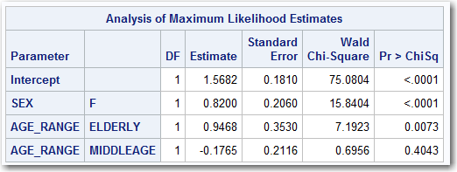
Method 4: Logistic Hurdle Model
OUTPUT:
Coefficients to predict if a person takes a shower (ShowerLength>0).

Slide 78
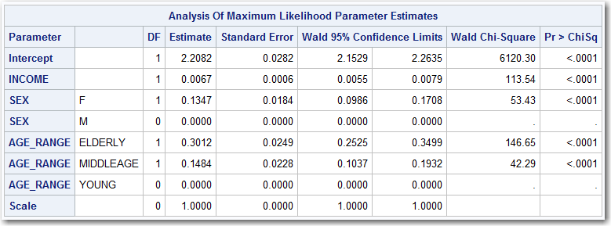
Method 4: Logistic Hurdle Model
OUTPUT:
Coefficients to predict the length of a shower (minus 1), assuming that a shower was taken.

Slide 79
Method 4: Logistic Hurdle Model
CONVERTING PARAMETERS INTO SCORE CODE:
In order to create stand alone score code, both models need to be implemented into a data step. The first model, predicts the amount of time in the shower assuming that the person takes a shower (no zero values).
STEP 1: START WITH AN EMPTY DATA STEP
data &TEMPFILE.;
set &TEMPFILE.;
run;

Slide 80
Method 4: Logistic Hurdle Model
CONVERTING PARAMETERS INTO SCORE CODE:
STEP 2: Use the parameters from LOGISTIC REGRESSION to calculate the LOGIT of the probability that a person takes a shower. Call this value “TEMP”.
data &TEMPFILE.;
set &TEMPFILE.;
TEMP = 1.5682
+ (SEX in ("F")) *0.8200
+ (AGE_RANGE in ("ELDERLY")) * 0.9468
+ (AGE_RANGE in ("MIDDLEAGE")) * -0.1765;
run;

Slide 81
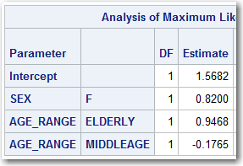
Method 4: Logistic Hurdle Model
CONVERTING PARAMETERS INTO SCORE CODE:
STEP 2: Use the parameters from LOGISTIC REGRESSION to calculate the LOGIT of the probability that a person takes a shower. Call this value “TEMP”.
data &TEMPFILE.;
set &TEMPFILE.;
TEMP = 1.5682
+ (SEX in ("F")) *0.8200
+ (AGE_RANGE in ("ELDERLY")) * 0.9468
+ (AGE_RANGE in ("MIDDLEAGE")) * -0.1765;
run;
The coefficients were found by PROC LOGISTIC.

Slide 82
Method 4: Logistic Hurdle Model
CONVERTING PARAMETERS INTO SCORE CODE:
STEP 2: Use the parameters from LOGISTIC REGRESSION to calculate the LOGIT of the probability that a person takes a shower. Call this value “TEMP”.
data &TEMPFILE.;
set &TEMPFILE.;
TEMP = 1.5682
+ (SEX in ("F")) *0.8200
+ (AGE_RANGE in ("ELDERLY")) * 0.9468
+ (AGE_RANGE in ("MIDDLEAGE")) * -0.1765;
run;

Slide 83
Method 4: Logistic Hurdle Model
CONVERTING PARAMETERS INTO SCORE CODE:
STEP 3: Convert the LOGIT value to a PROBABILITY that a person will take a shower. Call this value P_SCORE_FLAG.
data &TEMPFILE.;
set &TEMPFILE.;
TEMP = 1.5682
+ (SEX in ("F")) *0.8200
+ (AGE_RANGE in ("ELDERLY")) * 0.9468
+ (AGE_RANGE in ("MIDDLEAGE")) * -0.1765;
P_SCORE_FLAG = exp(TEMP) / (1+exp(TEMP));
run;

Slide 84
Method 4: Logistic Hurdle Model
CONVERTING PARAMETERS INTO SCORE CODE:
STEP 4: Use the parameters from GENMOD to calculate the amount of time that a person takes a shower. Call this value “TEMP”.
data &TEMPFILE.;
set &TEMPFILE.;
TEMP = 1.5682
+ (SEX in ("F")) *0.8200
+ (AGE_RANGE in ("ELDERLY")) * 0.9468
+ (AGE_RANGE in ("MIDDLEAGE")) * -0.1765;
P_SCORE_FLAG = exp(TEMP) / (1+exp(TEMP));
TEMP = 2.2082
+ INCOME * 0.0067
+ (SEX in ("F")) *0.1347
+ (AGE_RANGE in ("ELDERLY")) * 0.3012
+ (AGE_RANGE in ("MIDDLEAGE")) * 0.1484;
run;

Slide 85
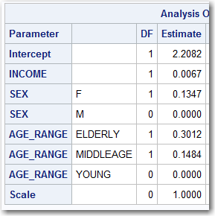
Method 4: Logistic Hurdle Model
CONVERTING PARAMETERS INTO SCORE CODE:
STEP 4: Use the parameters from GENMOD to calculate the amount of time that a person takes a shower. Call this value “TEMP”.
data &TEMPFILE.;
set &TEMPFILE.;
TEMP = 1.5682
+ (SEX in ("F")) *0.8200
+ (AGE_RANGE in ("ELDERLY")) * 0.9468
+ (AGE_RANGE in ("MIDDLEAGE")) * -0.1765;
P_SCORE_FLAG = exp(TEMP) / (1+exp(TEMP));
TEMP = 2.2082
+ INCOME * 0.0067
+ (SEX in ("F")) *0.1347
+ (AGE_RANGE in ("ELDERLY")) * 0.3012
+ (AGE_RANGE in ("MIDDLEAGE")) * 0.1484;
run;
The coefficients were found by PROC GENMOD.

Slide 86
Method 4: Logistic Hurdle Model
CONVERTING PARAMETERS INTO SCORE CODE:
STEP 4: Use the parameters from GENMOD to calculate the amount of time that a person takes a shower. Call this value “TEMP”.
data &TEMPFILE.;
set &TEMPFILE.;
TEMP = 1.5682
+ (SEX in ("F")) *0.8200
+ (AGE_RANGE in ("ELDERLY")) * 0.9468
+ (AGE_RANGE in ("MIDDLEAGE")) * -0.1765;
P_SCORE_FLAG = exp(TEMP) / (1+exp(TEMP));
TEMP = 2.2082
+ INCOME * 0.0067
+ (SEX in ("F")) *0.1347
+ (AGE_RANGE in ("ELDERLY")) * 0.3012
+ (AGE_RANGE in ("MIDDLEAGE")) * 0.1484;
run;

Slide 87
Method 4: Logistic Hurdle Model
CONVERTING PARAMETERS INTO SCORE CODE:
STEP 5: Convert “TEMP” into the Minutes spent in the shower (assuming that a shower was taken). Call this value P_SCORE_AMT.
data &TEMPFILE.;
set &TEMPFILE.;
TEMP = 1.5682
+ (SEX in ("F")) *0.8200
+ (AGE_RANGE in ("ELDERLY")) * 0.9468
+ (AGE_RANGE in ("MIDDLEAGE")) * -0.1765;
P_SCORE_FLAG = exp(TEMP) / (1+exp(TEMP));
TEMP = 2.2082
+ INCOME * 0.0067
+ (SEX in ("F")) *0.1347
+ (AGE_RANGE in ("ELDERLY")) * 0.3012
+ (AGE_RANGE in ("MIDDLEAGE")) * 0.1484;
P_SCORE_AMT = exp(TEMP) + 1;
run;

Slide 88
Method 4: Logistic Hurdle Model
CONVERTING PARAMETERS INTO SCORE CODE:
STEP 5: Recall that a value of 1 must be added to the scored value to account for the fact that 1 was subtracted earlier in the process.
data &TEMPFILE.;
set &TEMPFILE.;
TEMP = 1.5682
+ (SEX in ("F")) *0.8200
+ (AGE_RANGE in ("ELDERLY")) * 0.9468
+ (AGE_RANGE in ("MIDDLEAGE")) * -0.1765;
P_SCORE_FLAG = exp(TEMP) / (1+exp(TEMP));
TEMP = 2.2082
+ INCOME * 0.0067
+ (SEX in ("F")) *0.1347
+ (AGE_RANGE in ("ELDERLY")) * 0.3012
+ (AGE_RANGE in ("MIDDLEAGE")) * 0.1484;
P_SCORE_AMT = exp(TEMP) + 1;
run;

Slide 89
Method 4: Logistic Hurdle Model
CONVERTING PARAMETERS INTO SCORE CODE:
STEP 6: Multiply P_SCORE_FLAG and P_SCORE_AMT and to determine the expected time in the shower. Call this value P_SCORE_HURDLE.
data &TEMPFILE.;
set &TEMPFILE.;
TEMP = 1.5682
+ (SEX in ("F")) *0.8200
+ (AGE_RANGE in ("ELDERLY")) * 0.9468
+ (AGE_RANGE in ("MIDDLEAGE")) * -0.1765;
P_SCORE_FLAG = exp(TEMP) / (1+exp(TEMP));
TEMP = 2.2082
+ INCOME * 0.0067
+ (SEX in ("F")) *0.1347
+ (AGE_RANGE in ("ELDERLY")) * 0.3012
+ (AGE_RANGE in ("MIDDLEAGE")) * 0.1484;
P_SCORE_AMT = exp(TEMP) + 1;
P_SCORE_HURDLE = P_SCORE_FLAG * P_SCORE_AMT;
run;

Slide 90
Method 4: Logistic Hurdle Model
CHECK THAT EXPECTED TIME IN THE SHOWER IS THE SAME:
A PROC PRINT of the first 10 values will demonstrate that the probability value of the expected time in the shower is the same value from PROC GENMOD and from the SCORE CODE.
proc print data=&TEMPFILE.(obs=10);
var P_TARGET_HURDLE P_SCORE_HURDLE;
run;

Slide 91
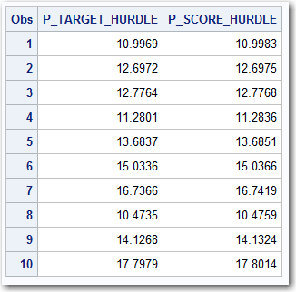
Method 4: Logistic Hurdle Model
CHECK THAT EXPECTED TIME IN THE SHOWER IS THE SAME:
A PROC PRINT of the first 10 values will demonstrate that the probability value of the expected time in the shower is the same value from PROC GENMOD and from the SCORE CODE. The values are close, but there are rounding errors.
proc print data=&TEMPFILE.(obs=10);
var P_TARGET_HURDLE P_SCORE_HURDLE;
run;

Slide 92
Model Validation

Slide 93
Model Validation Macro
MACRO:
The following macro will compare the accuracy of the various models against taking a simple average or “mean” value.
%FIND_ERROR( DATAFILE, P, MEANVAL );
DATAFILE = File with the scored values
P = Exponent of the Error.
A value of 1 will give the AVERAGE ERROR
A value of 2 will give the ROOT MEAN SQUARE ERROR
A value of some other constant, say 1.5, will use that exponent.
MEANVAL = This is the Mean or Average Value of the target

Slide 94
Model Validation Macro Code 1 of 2
%macro FIND_ERROR( DATAFILE, P, MEANVAL );
%let ERRFILE = ERRFILE;
%let MEANFILE = MEANFILE;
data &ERRFILE.;
set &DATAFILE.;
ERROR_MEAN = abs( ShowerLength - &MEANVAL.) **&P.;
ERROR_POI = abs( ShowerLength - P_TARGET_POI ) **&P.;
ERROR_NB = abs( ShowerLength - P_TARGET_NB ) **&P.;
ERROR_ZIP = abs( ShowerLength - P_TARGET_ZIP ) **&P.;
ERROR_ZINB = abs( ShowerLength - P_TARGET_ZINB ) **&P.;
ERROR_HURDLE = abs( ShowerLength - P_TARGET_HURDLE ) **&P.;
run;
proc means data=&ERRFILE. noprint;
output out=&MEANFILE.
mean(ERROR_MEAN) = ERROR_MEAN
mean(ERROR_POI) = ERROR_POI
mean(ERROR_NB) = ERROR_NB
mean(ERROR_ZIP) = ERROR_ZIP
mean(ERROR_ZINB) = ERROR_ZINB
mean(ERROR_HURDLE) = ERROR_HURDLE
;
run;

Slide 95
Model Validation Macro Code 2 of 2
data &MEANFILE.;
length P 8.;
set &MEANFILE.;
P = &P.;
ERROR_MEAN = ERROR_MEAN ** (1.0/&P.);
ERROR_POI = ERROR_POI ** (1.0/&P.);
ERROR_NB = ERROR_NB ** (1.0/&P.);
ERROR_ZIP = ERROR_ZIP ** (1.0/&P.);
ERROR_ZINB = ERROR_ZINB ** (1.0/&P.);
ERROR_HURDLE = ERROR_HURDLE ** (1.0/&P.);
drop _TYPE_;
run;
proc print data=&MEANFILE.;
run;
%mend;
%FIND_ERROR( &TEMPFILE., 1 , 13.31 );
%FIND_ERROR( &TEMPFILE., 1.5 , 13.31 );
%FIND_ERROR( &TEMPFILE., 2 , 13.31 );

Slide 96
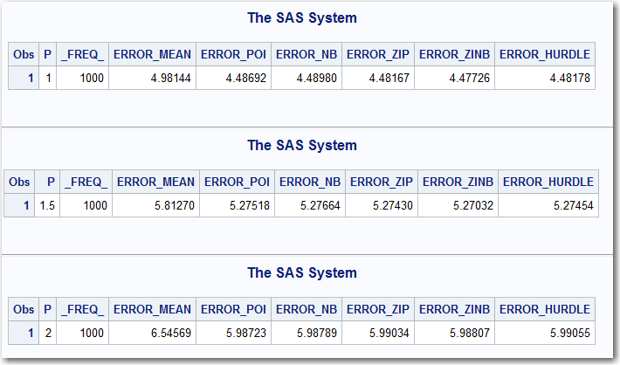
Model Validation Macro Code
OUTPUT:
The output to the macros is given below for P values of 1, 1.5, and 2

Slide 97
Model Validation Macro Code
OUTPUT:
The output to the macros is given below for P values of 1, 1.5, and 2

Slide 98
Model Validation Macro Code
OUTPUT:
Notice that at every value of “P”, the models are all better than the Mean value Model

Slide 99
Model Validation Macro Code
OUTPUT:
All the models performed with similar accuracy

Slide 100
Model Validation Macro Code
OUTPUT:
But in this particular case, the ZERO INFLATED NEGATIVE BINOMIAL model was best.

Slide 101
Model Validation Macro Code
In Summary:
All of the models had similar accuracy
All of the models outperformed a model that simply predicted the average or “mean” value
The ZERO INFLATED NEGATIVE BINOMIAL model outperformed the other models.
There is no way to know ahead of time which model approach will be the best, so it is important to try all of the techniques.

